Slide 1
IMMORTAL PLANTO
TEAM NAME : KEC BOYS
TEAM MEMBERS:
VASANTHARAN.K
VIJAYAKUMARAN.S
MOHAMED RIZWAN.M
VEENAS KUMAR.S

Slide 2
Problem:
Statement:-
There are more plants living in different environments. But each plant only grow in the particular environment and not the other. So making available the plants in the plant non- environmental condition places, it includes more transport charges and also we can't get it freshly. Also in our environment (i.e. in our fields) we can't get more than 85% of result in our farm and fields and our water usage also more , so less profit.

Slide 3
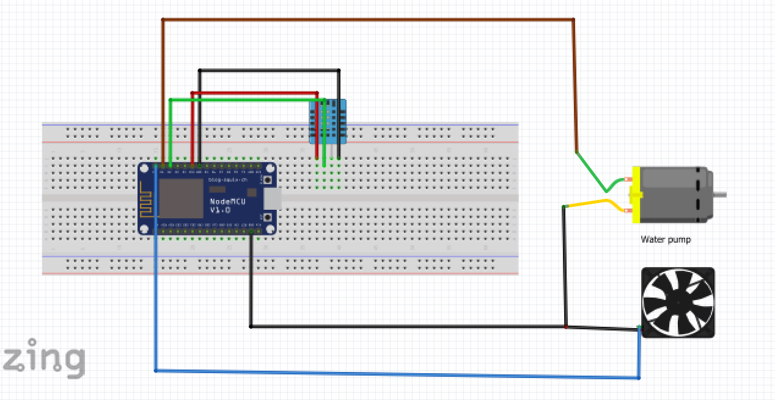
Prototype:

Slide 4
SOLUTION:
By this immortal planto implementation, we can grow the plants in its non-environmental conditions too. So that we can reduce the transport charge also we can get the fruits and vegetables readily and freshly. We can also get higher percentage of result from our fields by implementing this technique. Also we can reduce the amount of usage of water. Which also increases the profit of a farmer.

Slide 5
Things done So far:
We collect data’s of temperature and humidity from environment by IOT device.
From that data we designed an algorithm to solve this problem
In next stage from that algorithm we created a basic python code to implement our algorithm.
Finally the prototype is created from that python code.

Slide 6
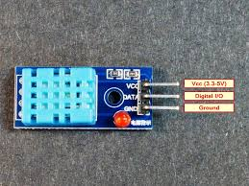
IOT Models used for data collecting
DHT -11 :- The DHT-11 Digital Temperature And Humidity Sensor is a basic, ultra low-cost digital temperature and humidity sensor. It uses a capacitive humidity sensor and a thermistor to measure the surrounding air and spits out a digital signal on the data pin (no analog input pins needed).

Slide 7
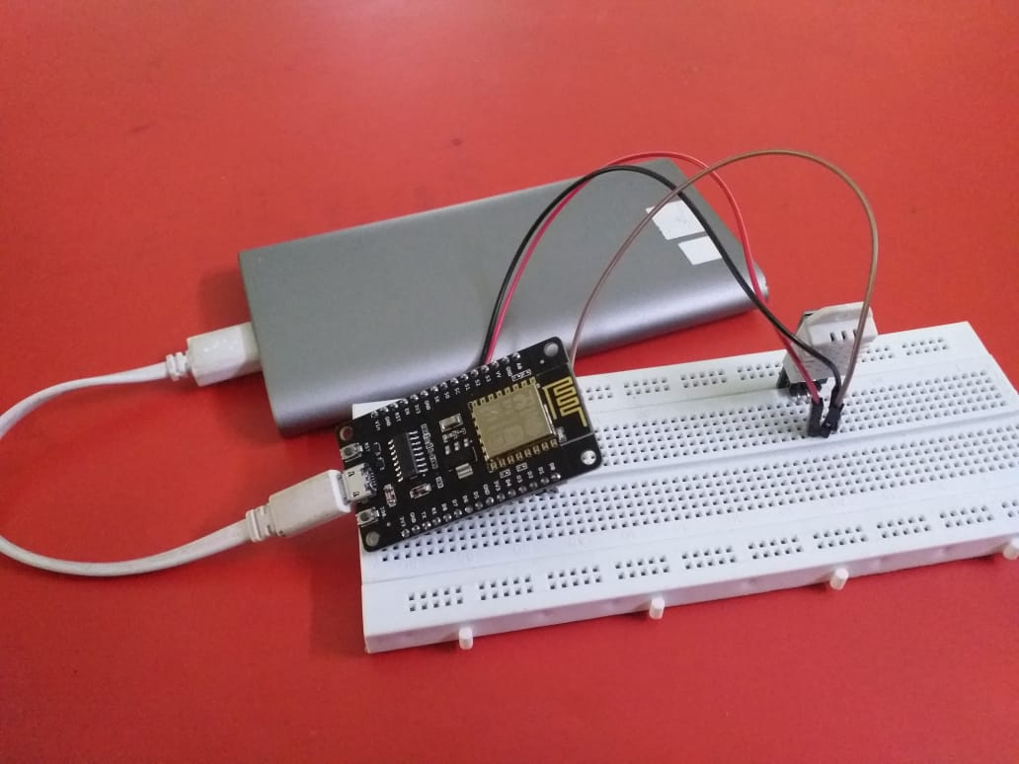
IOT Models used for data collecting
We created a model to collect data’s of temperature and Humidity. It can collect data’s from environment.

Slide 8
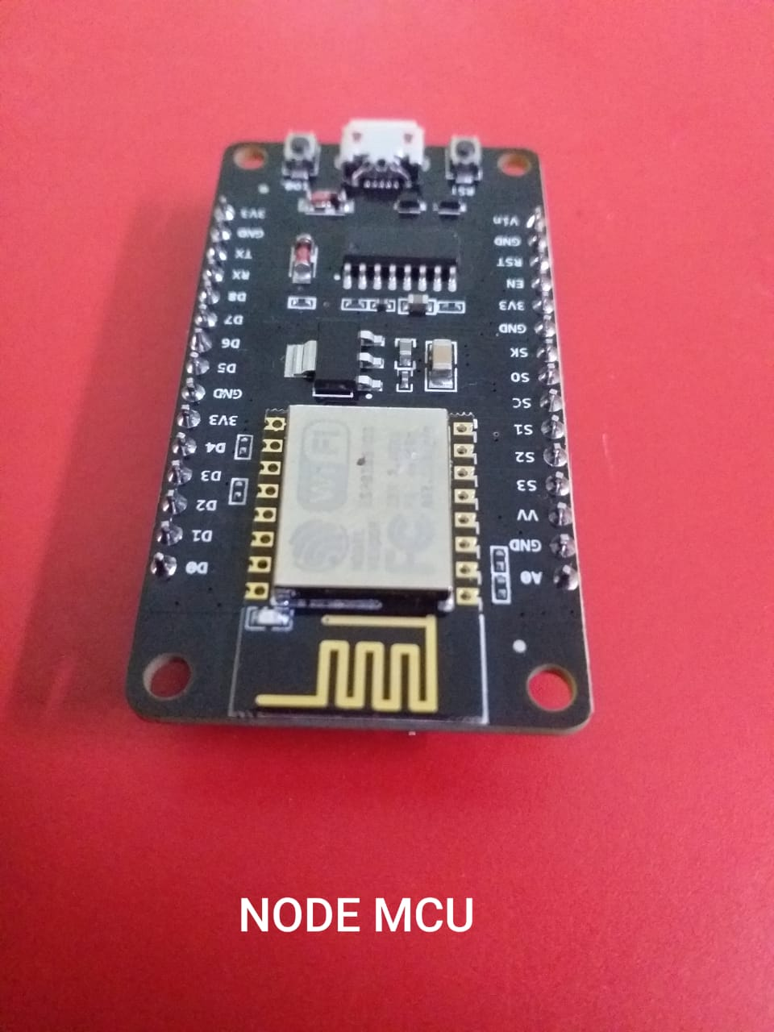
IOT Models used for data collecting
NODE MCU – Node-MCU is an open source platform based on ESP8266 which can connect objects and let data transfer using the Wi-Fi protocol. In addition, by providing some of the most important features of microcontrollers such as GPIO, PWM, ADC, and etc, it can solve many of the project's needs alone.

Slide 9
IOT Models used for data collecting
From those things we create a model. From that we can collect data’s and deploy in it in this project.
Things speak-channel :-
https://thingspeak.com/channels/1853896
Git-hub-link:-
https://github.com/KUMARANVASANTH/HACKATHON_kec_boys.git

Slide 10
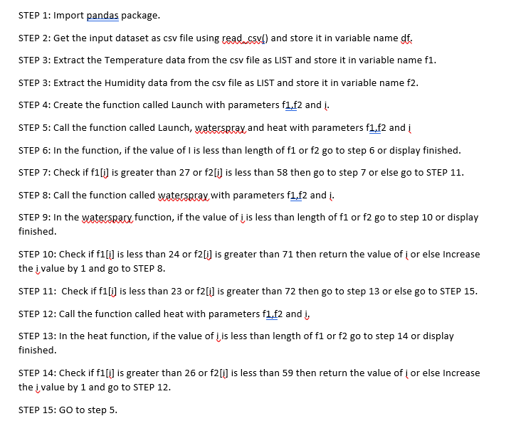
Algorithm:

Slide 11
Algorithm:
We have created a efficient algorithm to implement. Initially we code this in basic python.
The data’s which we feed to our program are,
Feed-1:-
https://github.com/KUMARANVASANTH/HACKATHON_kec_boys/blob/f03fb260228a1312ee9c43c1d7feed450bb45d07/ALGORITHM'S%20CODING/DATA%20USED%20FOR%20ALGORITHM%20TESTING/feeds-1.csv
Feed-2:-
https://github.com/KUMARANVASANTH/HACKATHON_kec_boys/blob/f03fb260228a1312ee9c43c1d7feed450bb45d07/ALGORITHM'S%20CODING/DATA%20USED%20FOR%20ALGORITHM%20TESTING/feeds-2.csv

Slide 12
Conclusion:
Finally we designed an prototype which we shown in previous slide.
From our solution we can harvest efficient crops with
Minimum water supply. It can make a new era.

